Slide 1
Control & Implementation of State Space Search
Dr. Keerthy A S

Slide 2
Control & Implementation of State Space Search
Recursion Based Search
Pattern Directed Search
Production Systems
Blackboard Architecture for Problem Solving

Slide 3
Journey so far…
Representation of a problem solution as a path from a start state to a goal
Systematic search of alternative paths
Backtracking from failures
Explicit records of states under consideration
open list: untried states
closed lists: to implement loop detection
open list is a stack for DFS, a queue for BFS

Slide 4

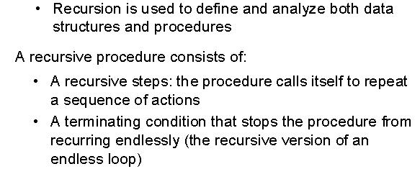

Slide 5
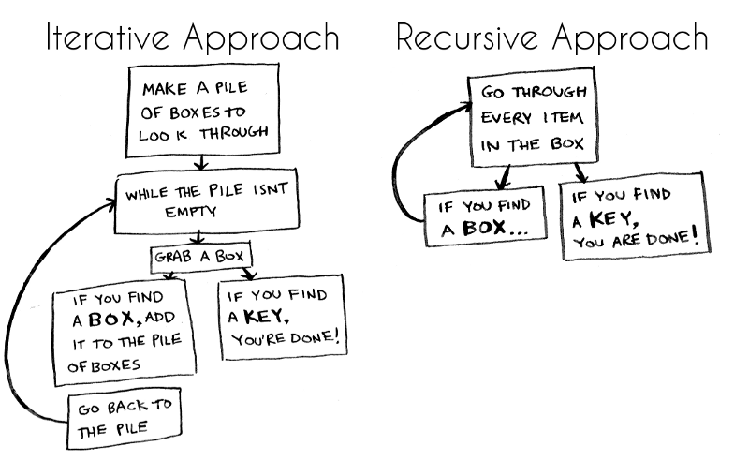
Recursion Based Search

Slide 6
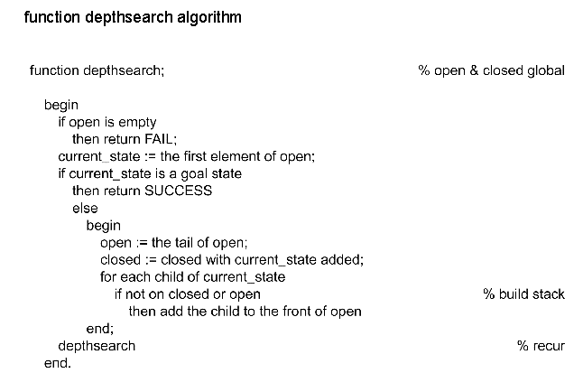
Does not utilize the full power of recursion
Use recursion to organize states and paths through state space
Global closed list – detects duplicate states and avoid loops & open list has activation records of recursive environments

Slide 7
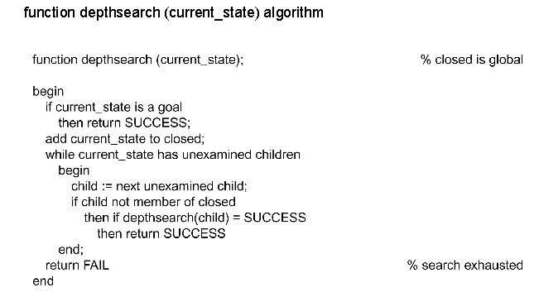
Produces child states one at a time and recursively searches the descendants of each child before generating its siblings
If some descendant of the child state is a goal the recursive call returns “success” and ignores the siblings
If the recursive call fails to find the goal, the next sibling is generated and all of its descendants are searched→ Backtracking

Slide 8
Use recursion
• for clarity, compactness, and simplicity
• call the algorithm recursively for each child
• the open list is not needed anymore, activation records take care of this
• still use the closed list for loop detection

Slide 9
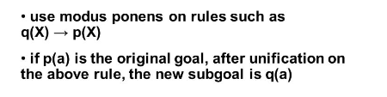
Pattern-Directed Search
The pattern-directed search uses unification to determine when two expressions match, and it uses modus ponens to generate the children states.

Slide 10
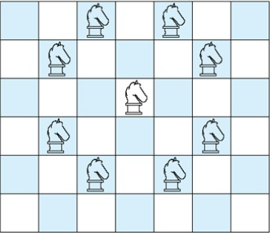
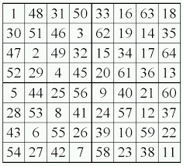
Legal moves of a chess knight
A knight’s tour is a series of moves that knight makes while visiting every cell of n x n of the chessboard exactly once.

Slide 11
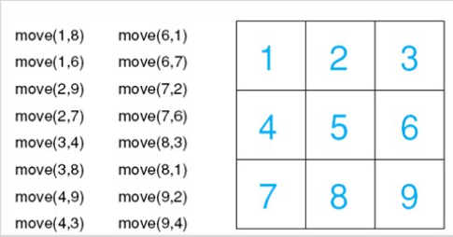
A 3 x 3 chessboard with move rules for the simplified knight tour problem

Slide 12
Production Systems

Slide 13
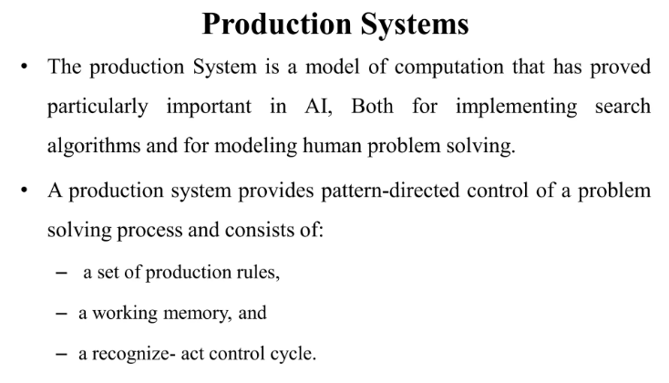

Slide 14
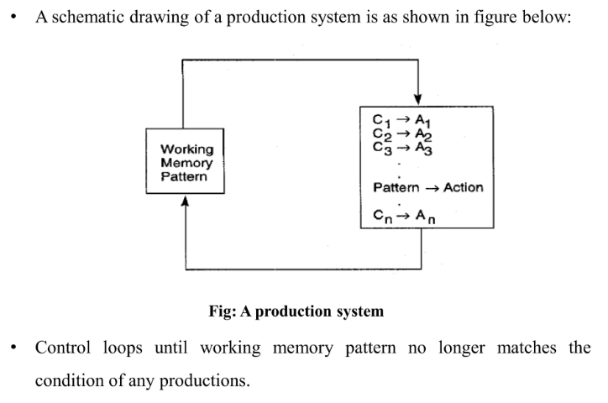

Slide 15
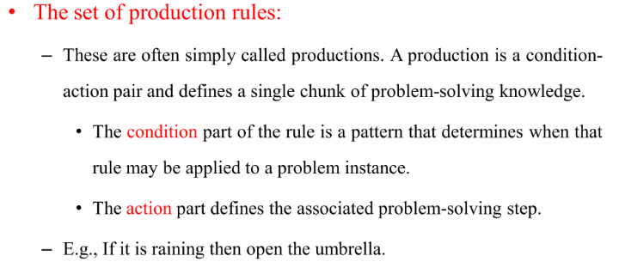

Slide 16
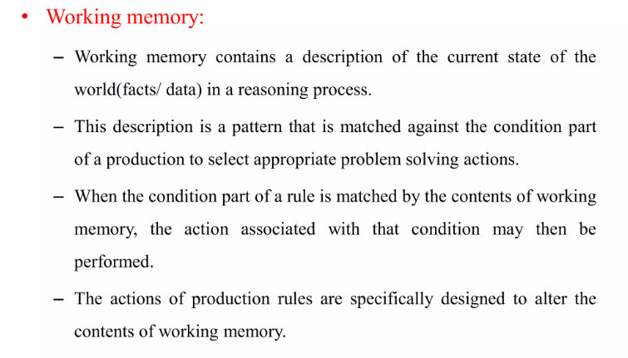

Slide 17
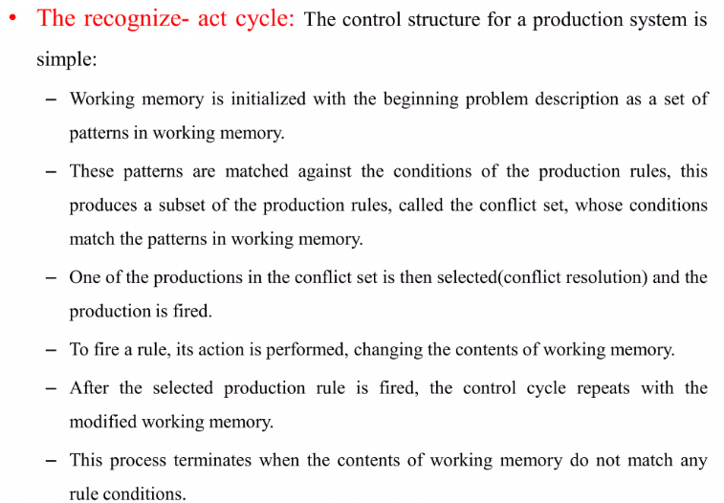

Slide 18
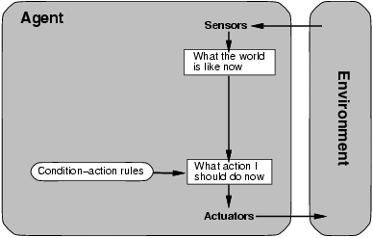
Simple reflex agent
Select action on the basis of current percept, ignoring all past percepts

Slide 19
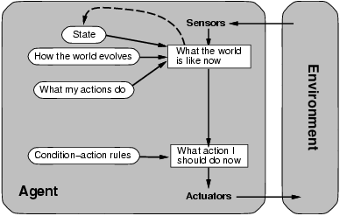
Model-based reflex agent
Maintains internal state that keeps track of aspects of the environment that cannot be currently observed

Slide 20
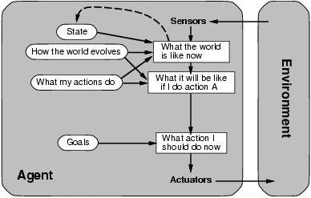
Goal-based agent
The agent uses goal information to select between possible actions in the current state

Slide 21
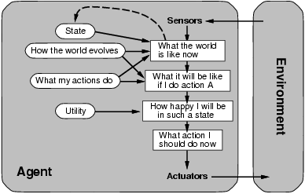
Utility-based agent
The agent uses a utility function to evaluate the desirability of states that could result from each possible action

Slide 22
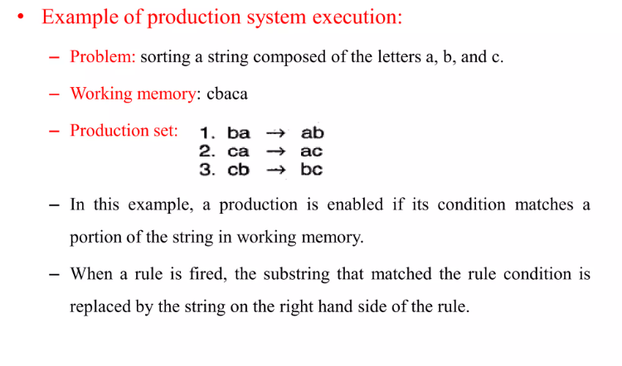

Slide 23
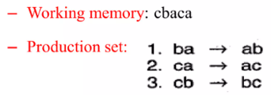
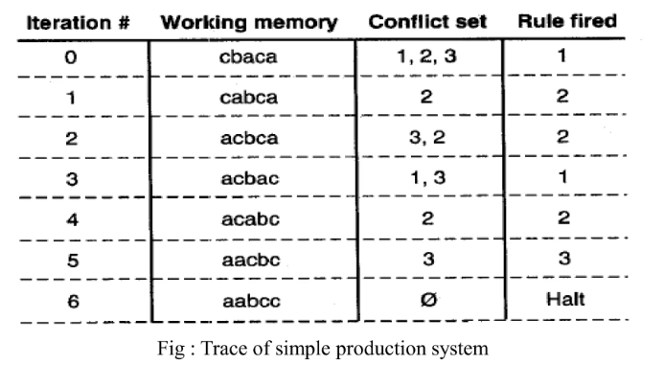

Slide 24
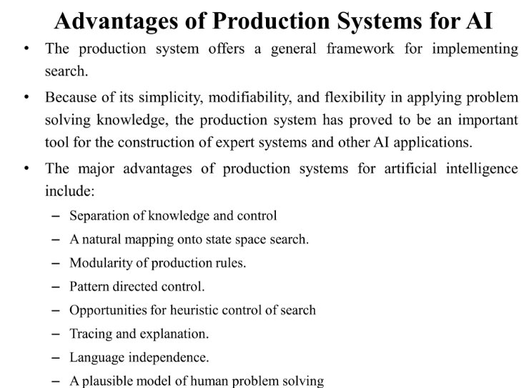

Slide 25
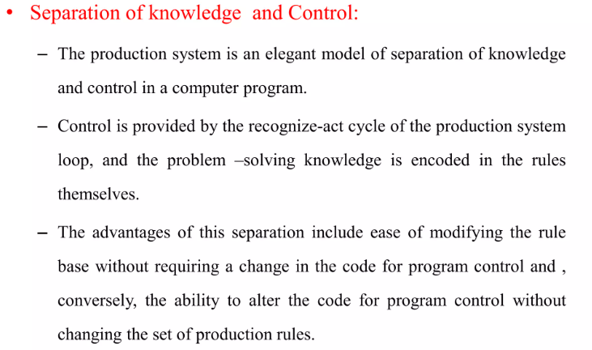

Slide 26
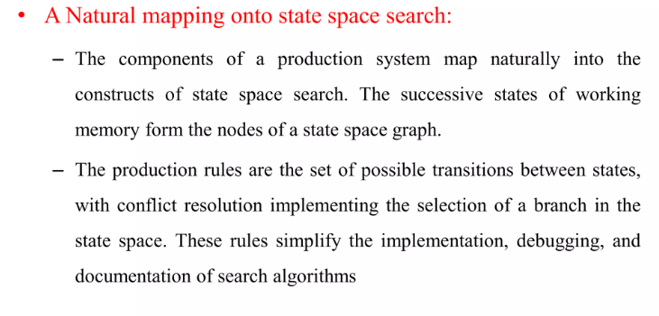

Slide 27
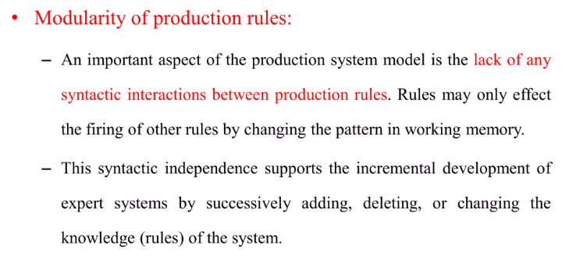

Slide 28
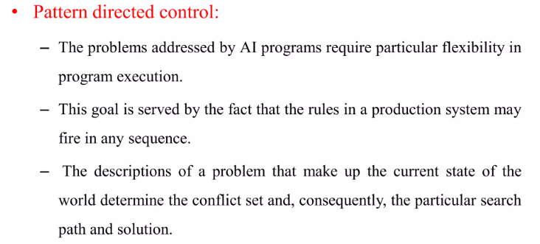
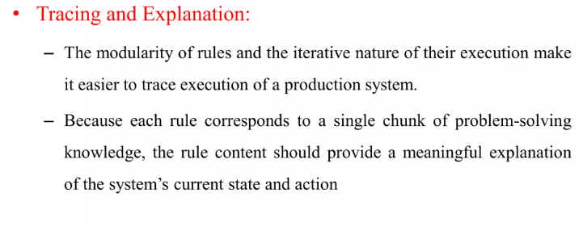

Slide 29
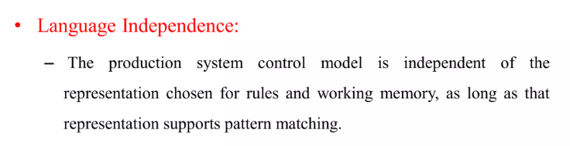
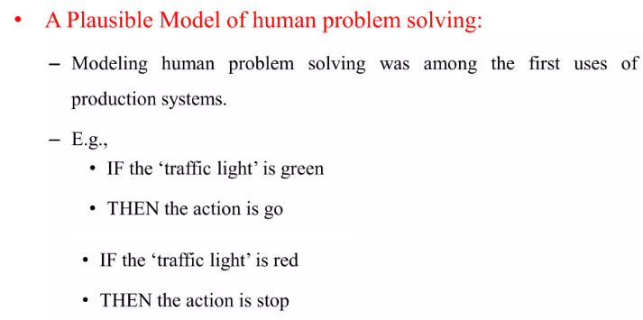

Slide 30
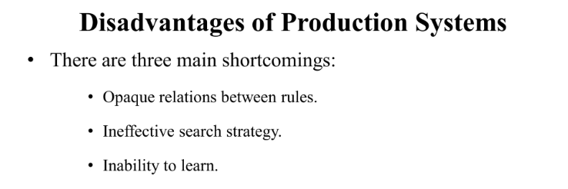

Slide 31
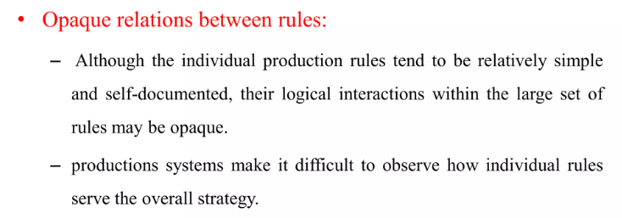
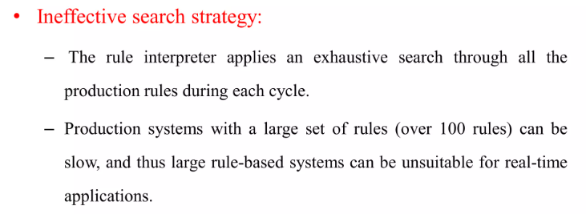

Slide 32
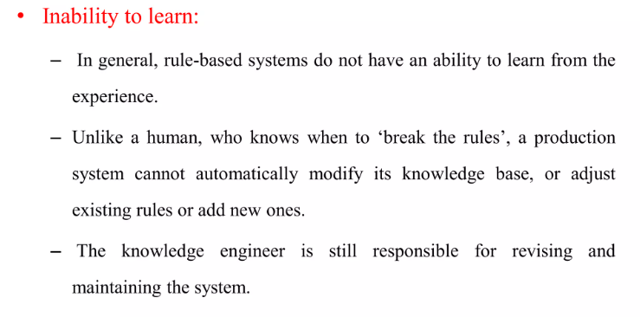

Slide 33
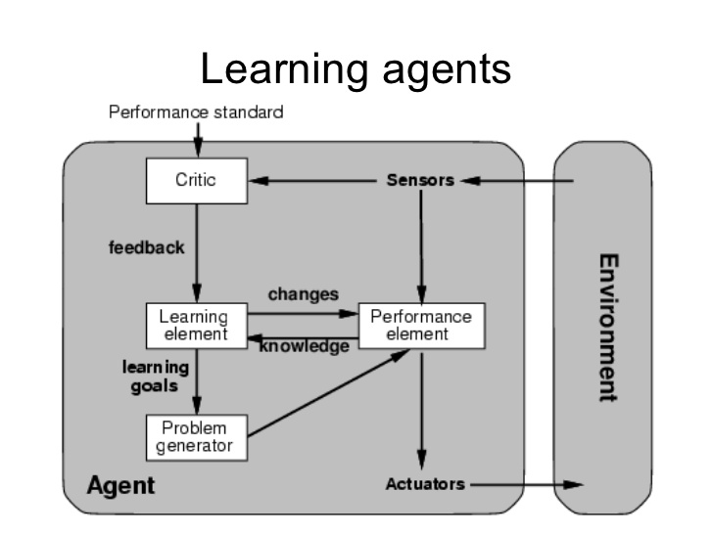
Where does learning come in?

Slide 35
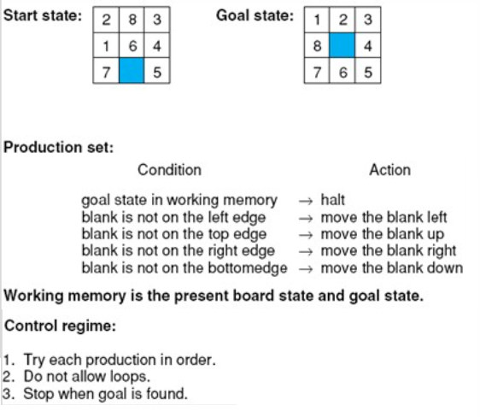
The 8-puzzle as a production System

Slide 36
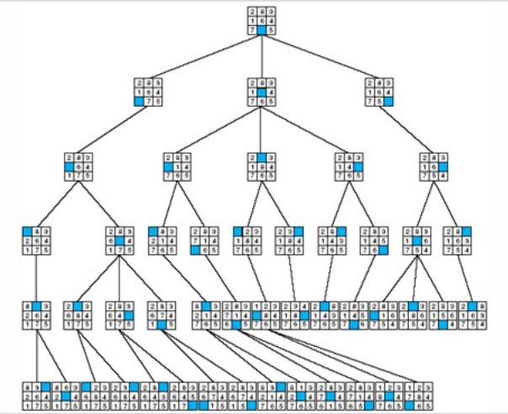

Slide 37
Control of search in Production Systems

Slide 38
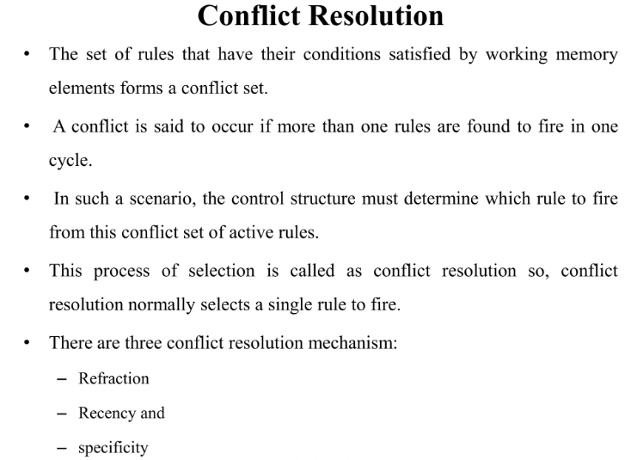

Slide 39
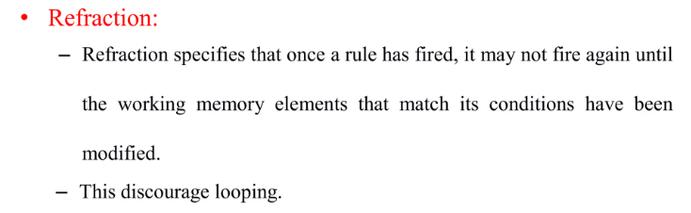
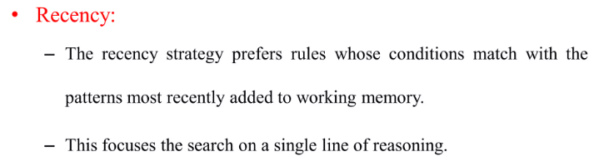
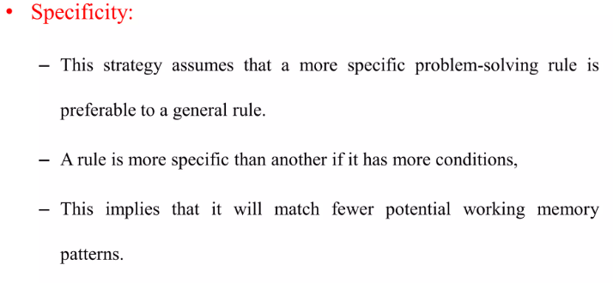

Slide 40
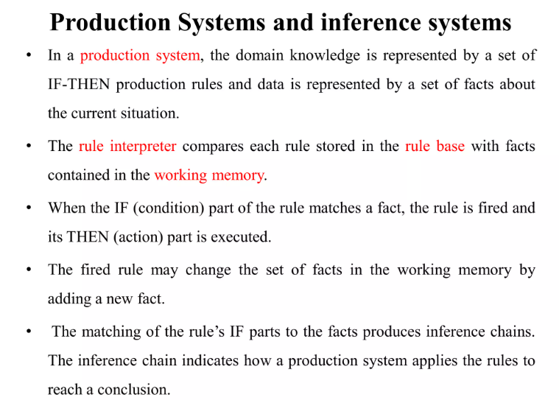

Slide 41
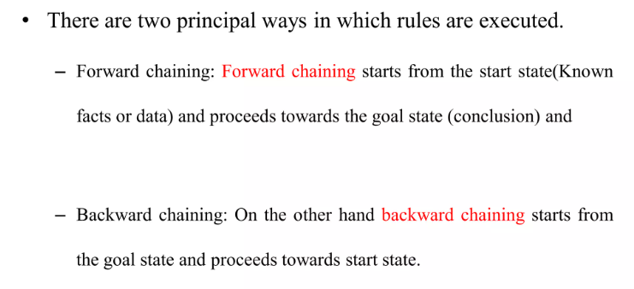

Slide 42
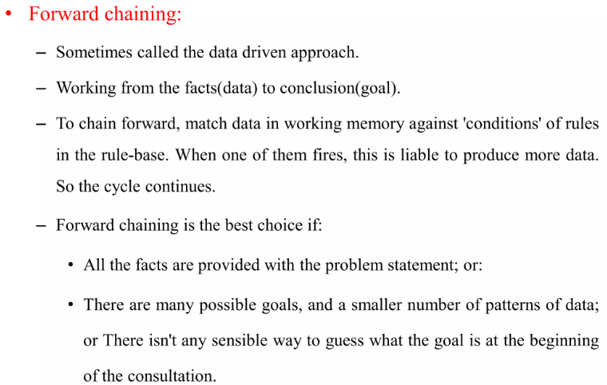

Slide 43
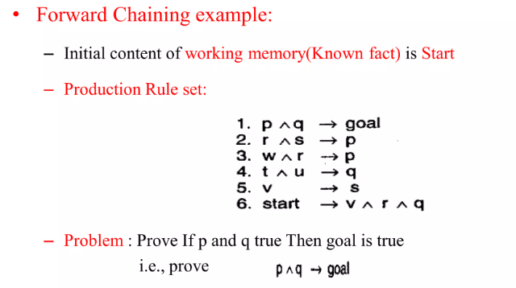

Slide 44
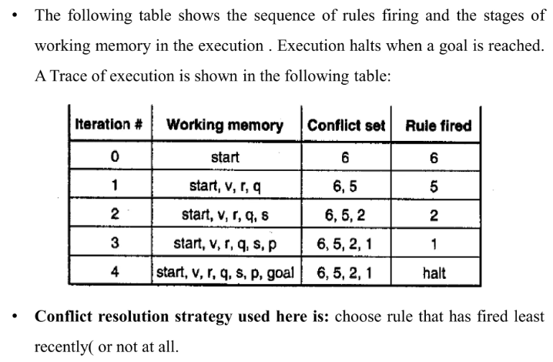
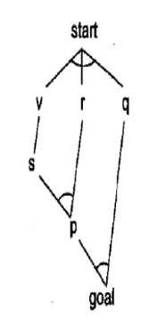

Slide 45
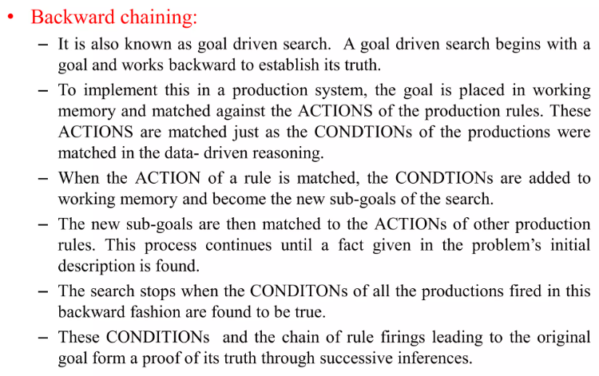

Slide 46
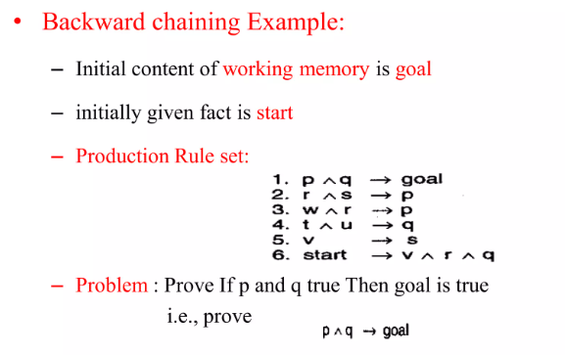

Slide 47
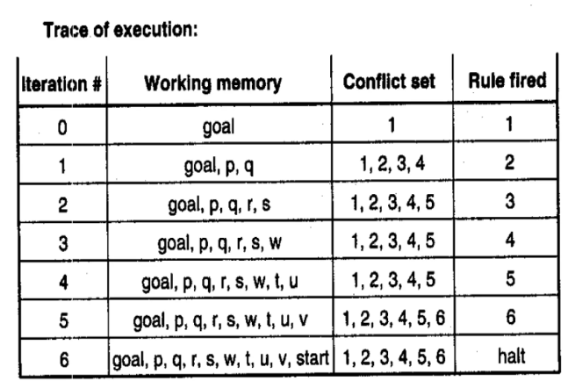
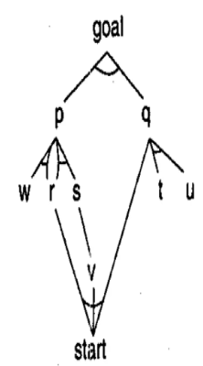

Slide 48
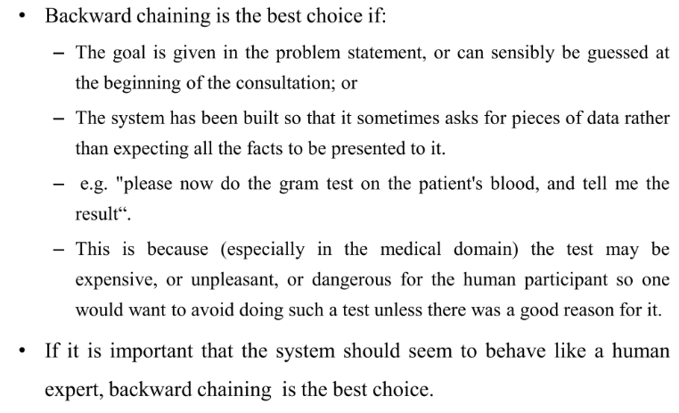

Slide 51


Blackboard architecture
The blackboard architecture is a model of control that has been applied to problems requiring the coordination of multiple processes or knowledge sources.
A blackboard is a central global database for the communication of asynchronous knowledge sources focusing on related aspects of a particular problem.

Slide 52


